Slide 1
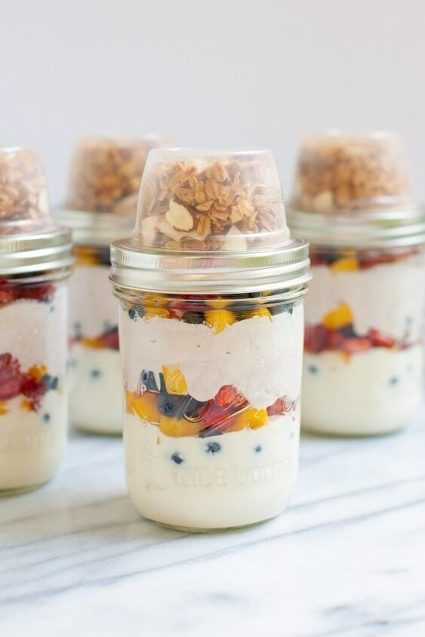
New Greek Yogurt Flavor Analysis
February 4, 2020
Team 4: Yueqing(Amiee) Yang, Sanket Gomase, Xueqing Hou, Ziting Liao, Meng Guo

Slide 2
Black cherry, raspberry, pineapple, and lemon are the final flavors to lauch for private label Greek yogurt
According to sales percentages:
Black cherry, raspberry, pineapple, and pomegranate are the potential new flavors to launch.
According to time trend of sales and unit sales:
Black cherry, raspberry, and pineapple are the potential new flavors to launch.
According to preferences shown in the survey data:
Raspberry and black cherry are the potential new flavors to launch.
According to TURF analysis:
Pineapple, lemon, and black cherry are the potential new flavors to launch.
According to Combo size analysis(Appendix IV):
4-5 units is the best combo size for new flavors to launch.
Final recommendation:
Black cherry, raspberry, pineapple, and lemon are the new flavors that the private label should launch.
Why lemon?
According to TURF analysis, consumers who eat lemon flavor are quite different from consumers who eat current flavors the private label have now. Launching lemon flavor can enlarge the market share of our private label yogurt.

Slide 3
Methodology
Time Trend (Appendix I)
We should launch the flavor whose sales increase sharply lately.
We will not launch the flavor whose sales decrease sharply, even though the sales of this flavor is high.
Except existing flavors, Black Cherry, Raspberry and Pineapple increase the most in 2011.
Unit Trend (Appendix II)
We should launch the flavors which have a larger unit.
Except existing flavors, Black Cherry, Raspberry and Pineapple sale the most unit in 2011
TURF analysis
We use TURF algorithm identifies the optimal product line to maximize the total number of consumers who will purchase at least one product. We only looks at the reach of the product range and ignoring the Frequency component of TURF.
STEP #1: Cleaning data
Delete incomplete responses ( V10 = 0 ).
Delete the abnormal total time response (less than 1 mins and more than 30 mins).
Change the digits meanings of Q12 ( change 1,2(not buy often) to 0; 0 (buy) to 1).
Choose the responses which prefer Greek yogurt more ( Q2_1 >= 50 ).
STEP #2: Apply the clean data to TURF function
We only consider about the binary problems so we set both 1 and 2 to “not buy”.
From the “origval” and “optval”, we can conclude that Pineapple, Lemon and Black Cherry flavor can contribute to the target consumers size.

Slide 4
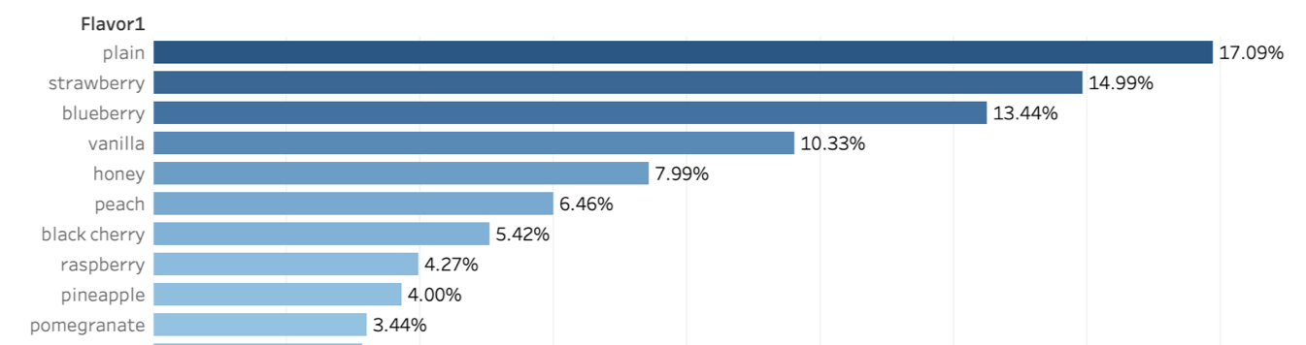
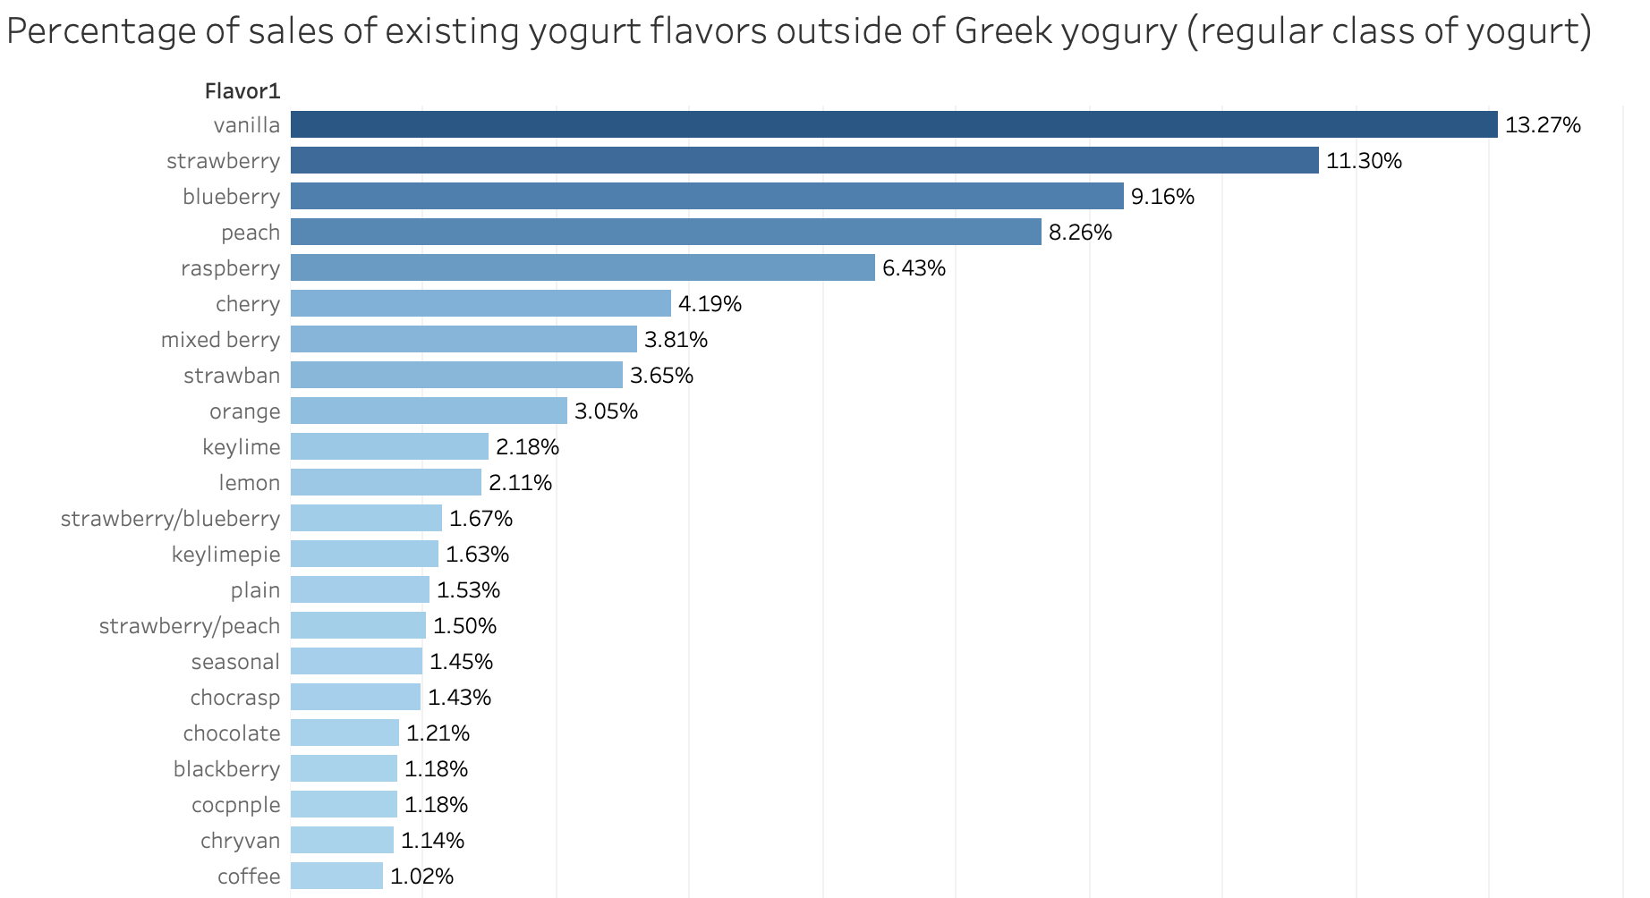
Black cherry, raspberry, pineapple, and pomegranate are potential next flavors to launch
Based on the percentage of sales of existing flavors in the Greek yogurt category (all brands)
Percentage of sales of existing flavors in the Greek Yogurt category (all brands)
All current flavors
Potential flavors to launch
Raspberry, cherry, mixed berry, and strawberry-banana are potential next flavors to launch
Based on the percentage of sales of existing yogurt flavors outside of Greek yogurt (regular class of yogurt)
Percentage of sales of existing yogurt flavors outside of Greek Yogurt (regular class of yogurt
Four of all current flavors
Potential flavors to launch

Slide 5
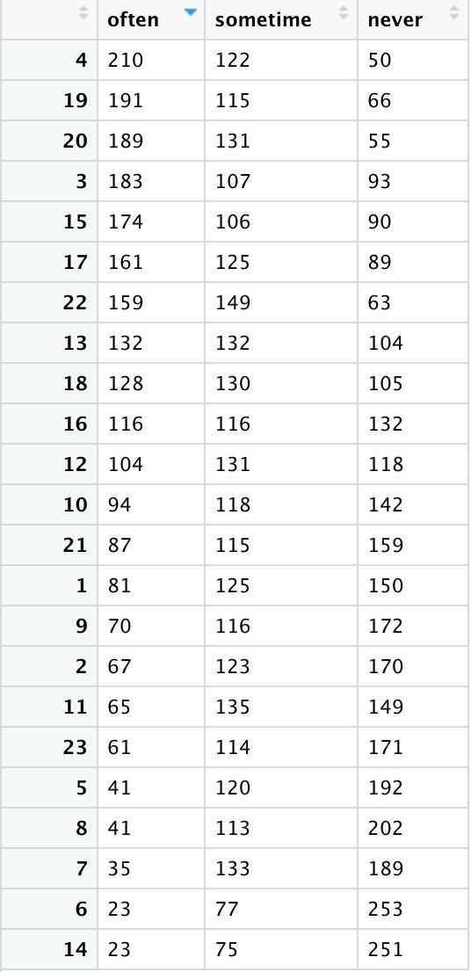
Blueberry, raspberry and strawberry are the most preferred flavors in survey data
We want to know the survey respondents’ preferences for Greek yogurt flavors, we first choose the respondents who only consumer Greek yogurt in the past month. (Q2_1 = 100)(Appendix III)
Then we get a table which can describe the customers’ preference and then order the flavor by the frequency of ‘often’.
According to the table data, the most popular flavor is Blueberry, which we have already had, the following popular flavors are Raspberry, Strawberry, Black cherry, Peach, Plain, Vanilla and Mango.
From the survey data information, we should lauch Raspberry and Blackcherry flavor Greek yogurt.

Slide 6
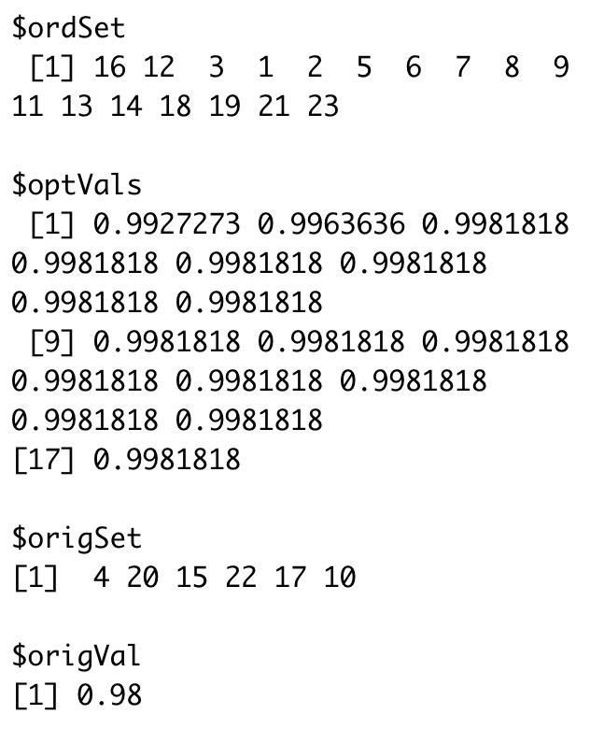
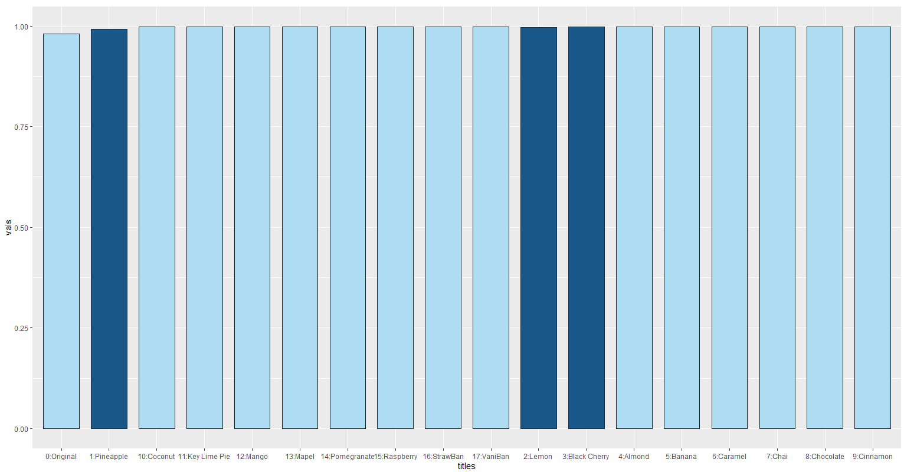
Pineapple, lemon, and black cherry are the potential next flavors to launch based on TURF analysis
Pineapple
Lemon
Black Cherry
Originally, with the existing 6 flavors, we can reach 98% consumers.
After introducing Pineapple flavor, we can reach 99.27% customers.
After introducing Pineapple and Lemon flavor, we can reach 99.64%.
After introducing Pineapple, Lemon, and Black Cherry, we can reach 99.82%.

Slide 7
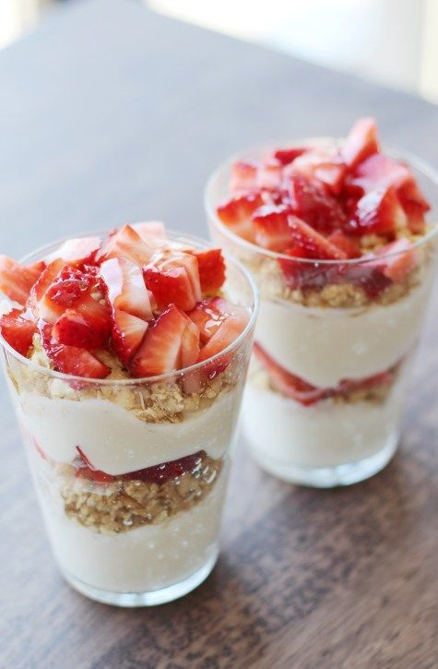
Appendix

Slide 8
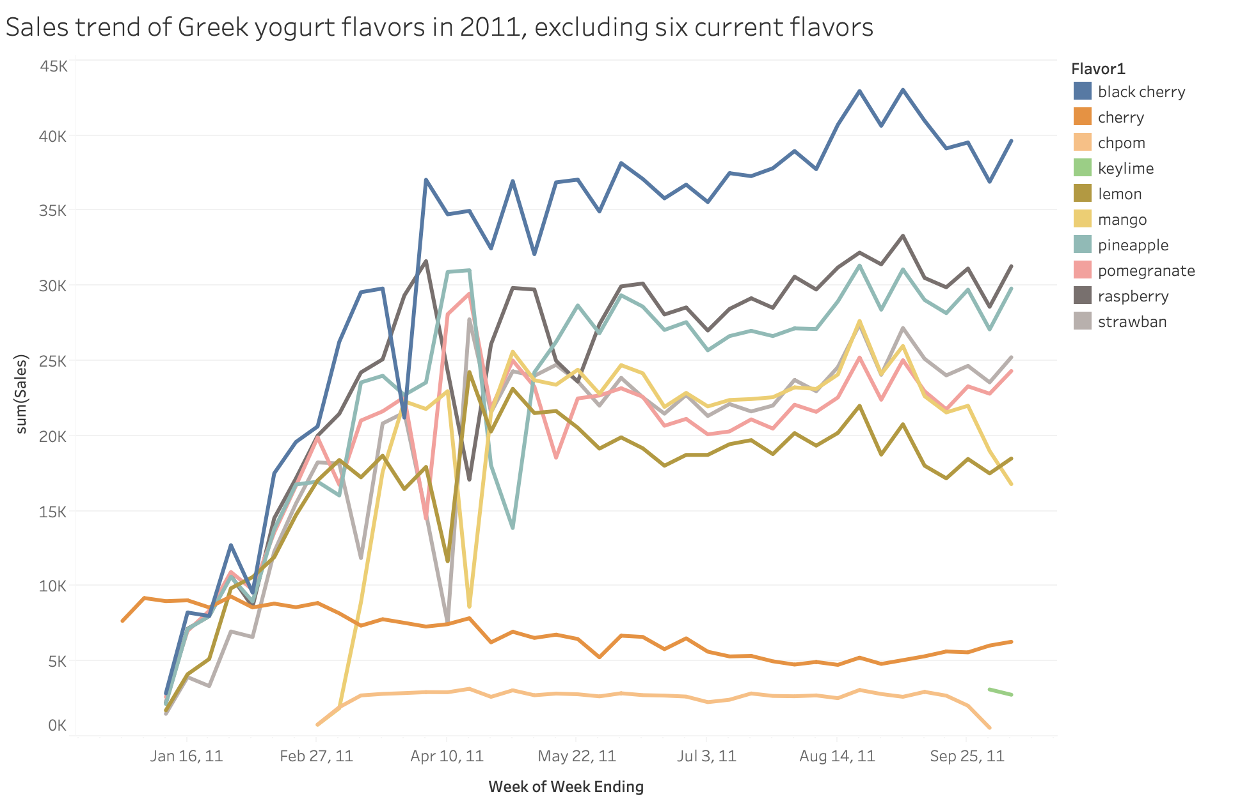
Appendix I:Sales of black cherry, raspberry, and pineapple Greek yogurt increased the most in 2011
#1: Black cherry
#2: Raspberry
#3:Pineapple
Methodology

Slide 9
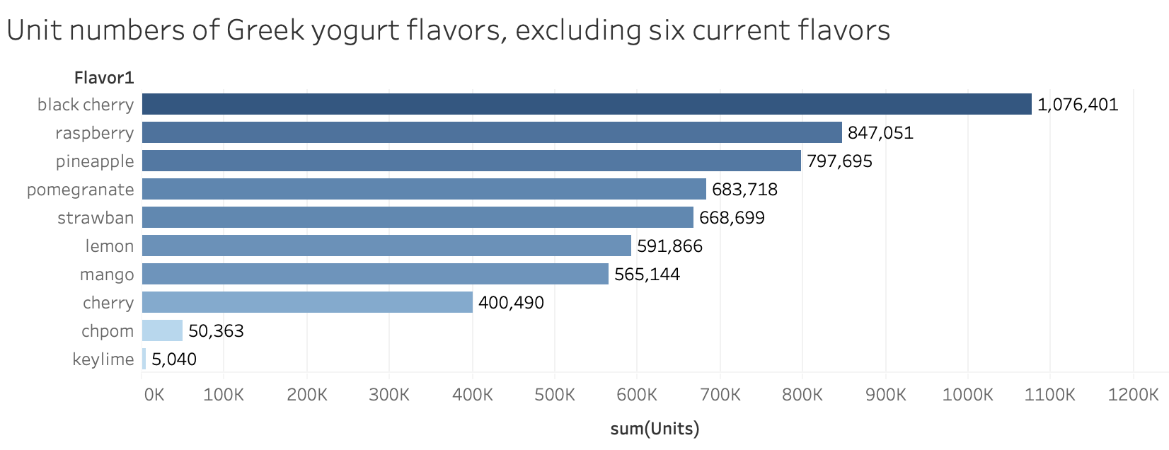
Appendix II:Unit sales of black cherry, raspberry, and pineapple Greek yogurt are the most
Methodology

Slide 10
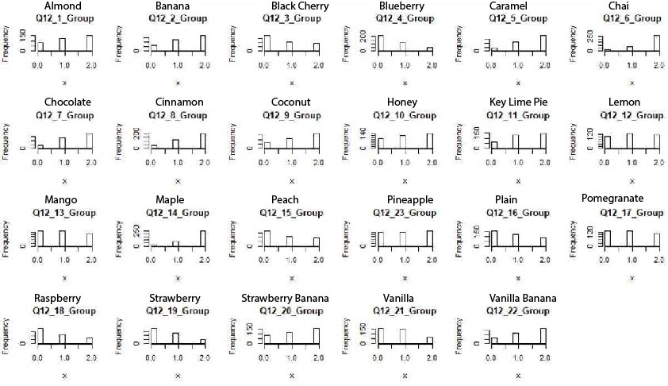
Appendix III: Frequency of the Greek yogurt flavor in survey data
Detail

Slide 11
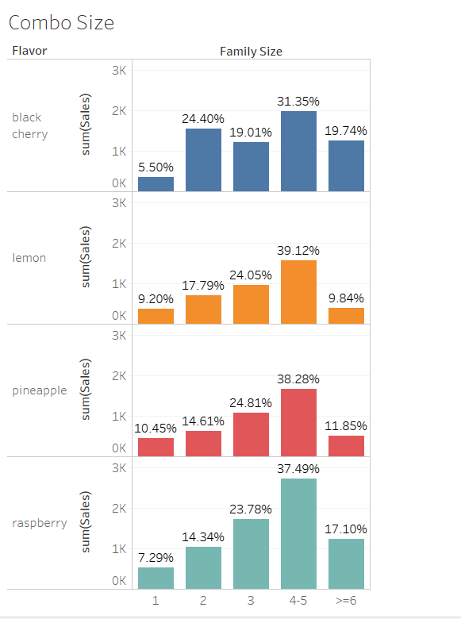
Appendix IV: Combo size analysis
Design refinement: we further did a family size analysis to determine what size of yogurt combo the brand should launch using the surveys data. we found out that in most occasions, the families sizes are 4-5, so maybe besides separate packing, the brand can also launch the 4-5 packing combo.
Highlight

